Slide 1
Free and Open Source Tools for Patent Analytics with reference to the WIPO Manual
Irene Kitsara, IP Information Officer,
Access to Information and Knowledge Division

Slide 2
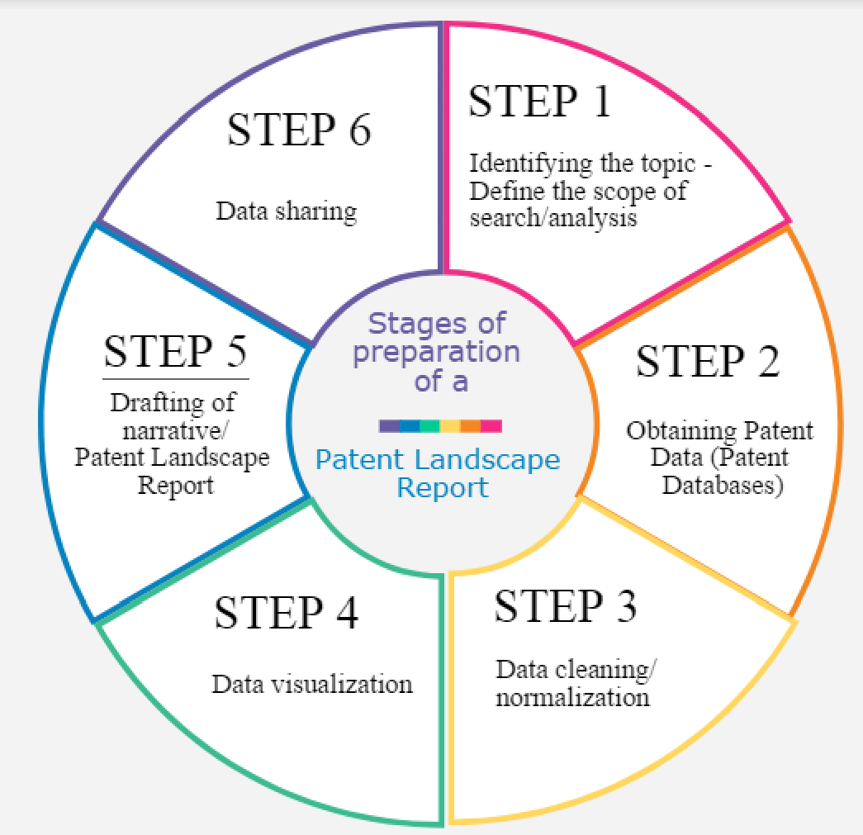
Stages of preparation of a PLR

Slide 3
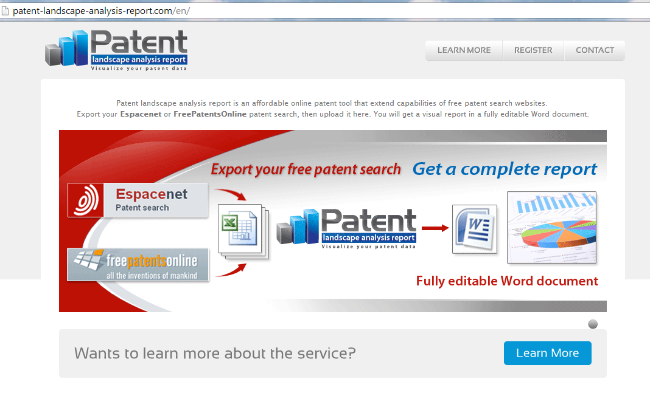
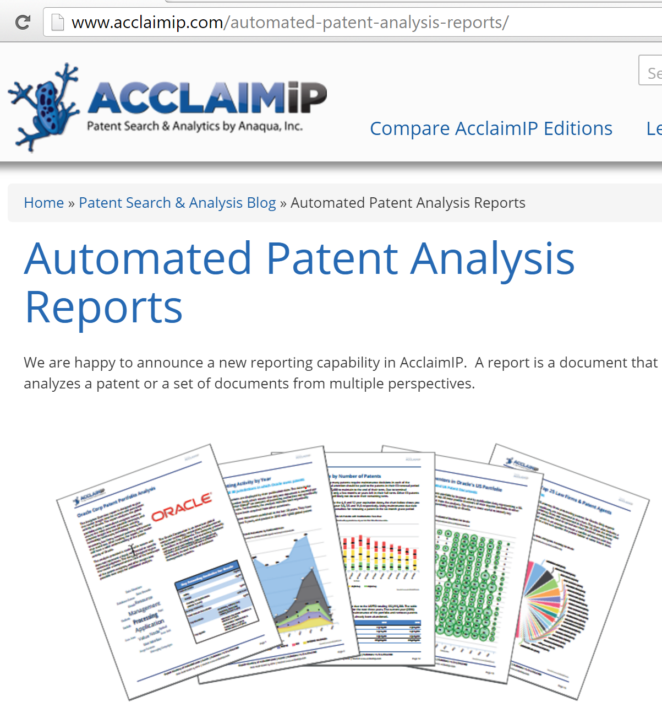
Tools for PLR Preparation
Efforts to create online semi-automated tools for the preparation of (semi-) automated PLR, e.g.

Slide 4
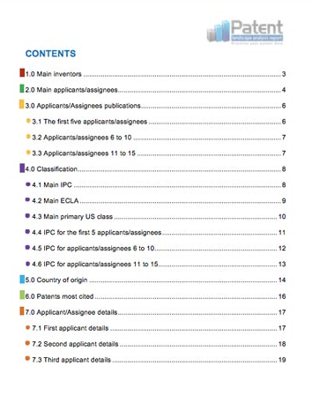
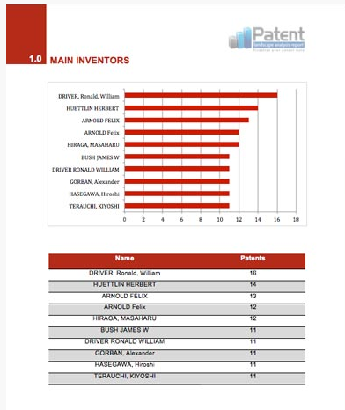
Tools for PLR preparation (2)

Slide 5

Tasks associated with Patent Analytics and Related Tools
Tasks and Tool types
Notes
General Tools
Search tools
Cleaning
Text/data mining
Data Visualization
Geographic Mapping
Network visualizations
Infographics
One tool suits all?
Some tools address multiple tasks
Each tool based on different language/approach
Each user should follow the «trial and error» approach

Slide 6
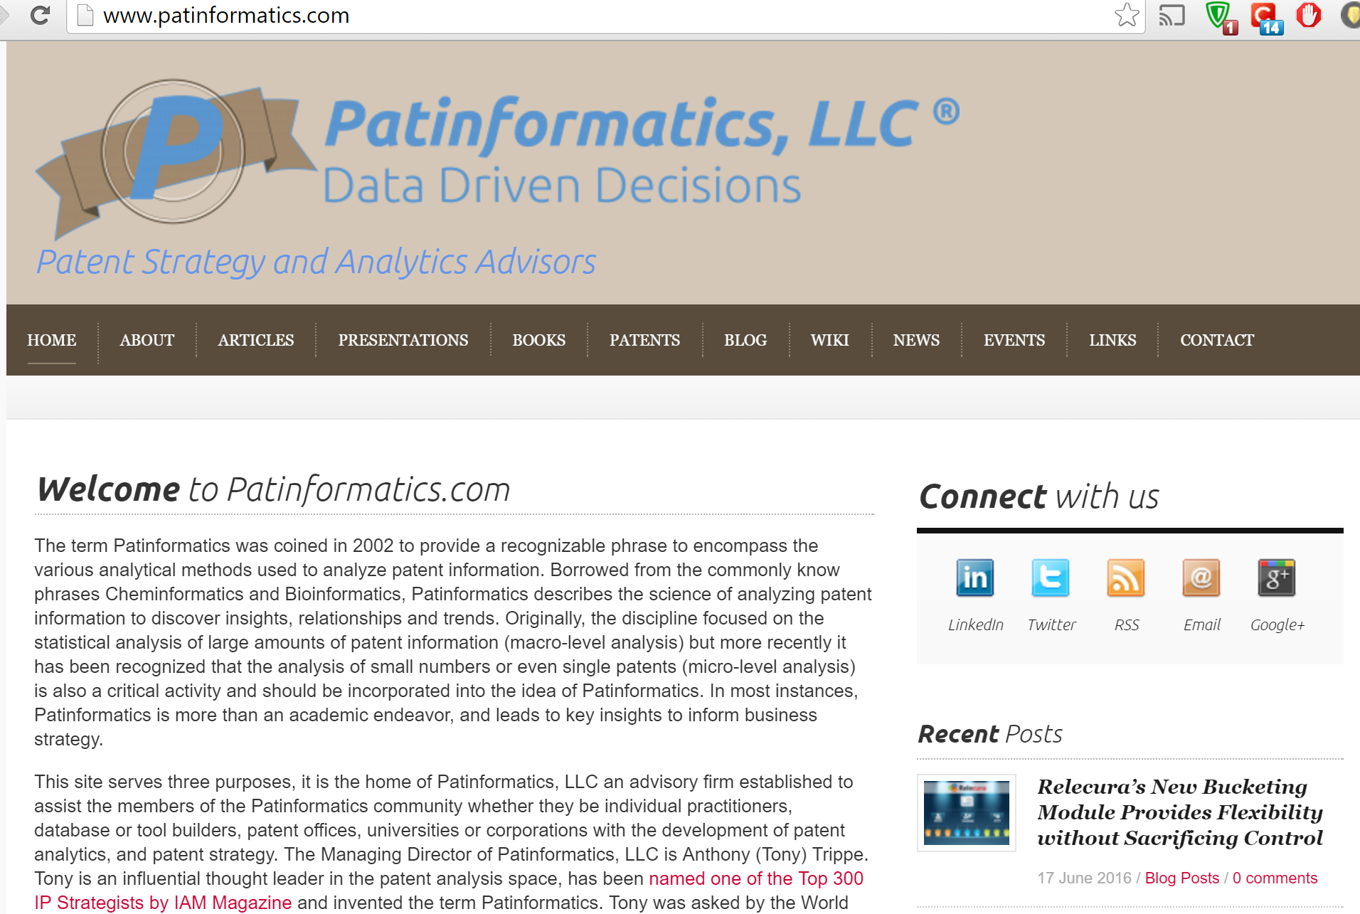
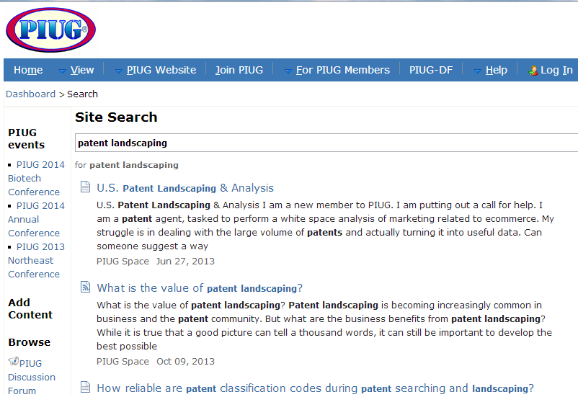
Blogs/Wiki/Online Fora on Patent Landscaping
www.patinformatics.com
http://wiki.piug.org

Slide 7
What type of tools are used in patent analytics?
To help in various stages and tasks involved in patent analytics:
(Searching)
Obtaining
Cleaning/Normalizing
Grouping/Clustering Data
Analyzing
Visualizing
Sharing

Slide 8






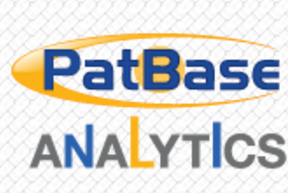





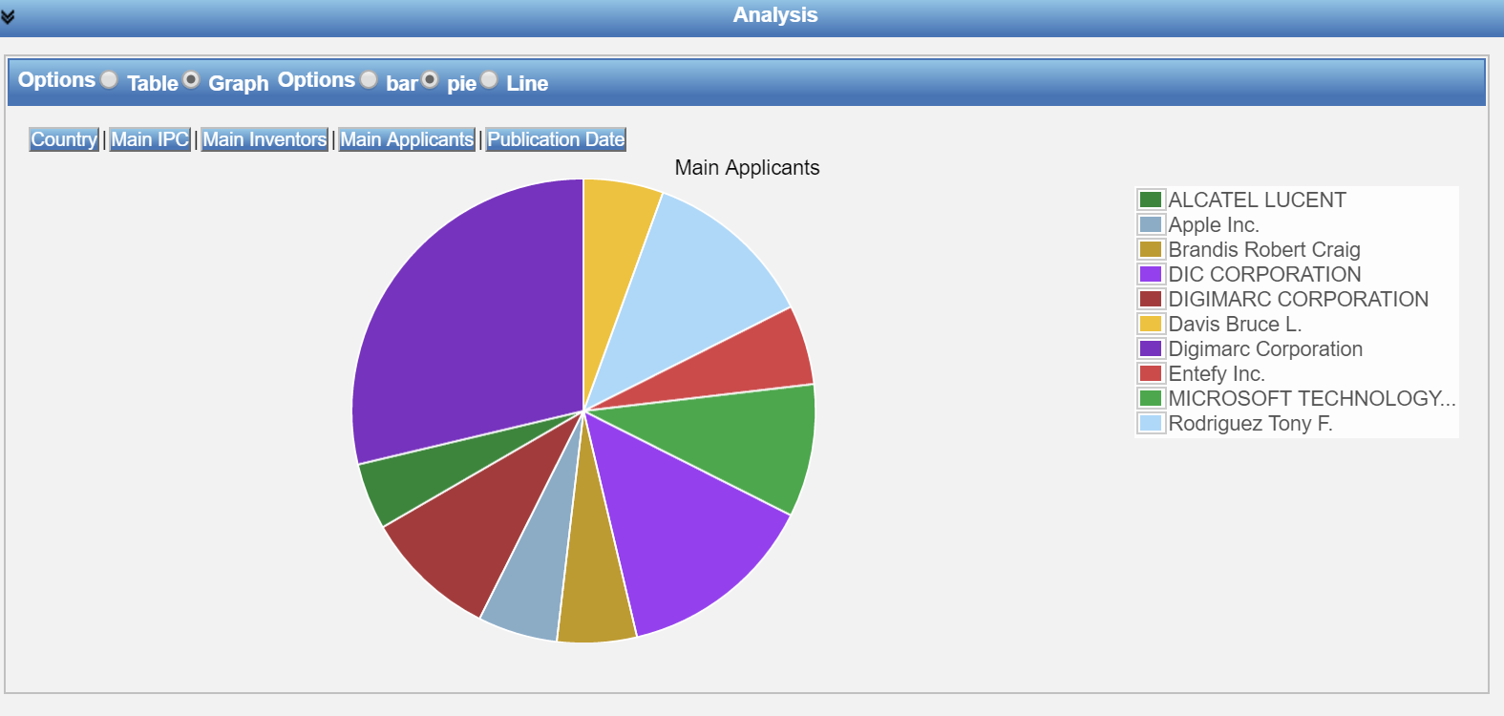

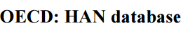

Tools used in Patent Analytics
Commercial:
Embedded in patent databases
Complementary to patent search tools and compatible
Typically dedicated to patent data, with some exceptions
Free of charge:
Some possibilities
Open Source Tools: recent trend

Slide 9
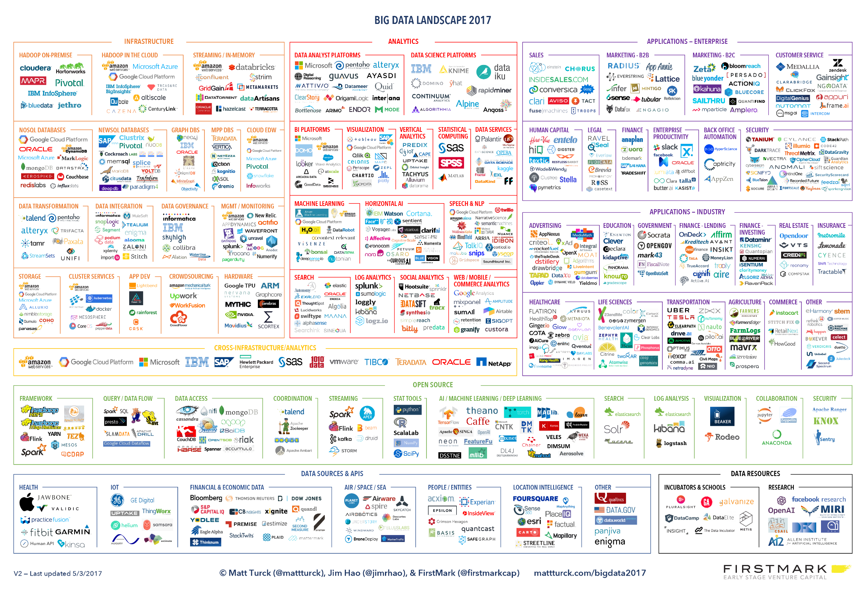
(…some of the) tools facilitating data analysis

Slide 10
Which tools are used in patent analytics?

Slide 11
WIPO Survey on the use of open source and free tools for patent analytics
Survey addressed to the community of patent information users on the tools they are using for patent analysis
13 questions in SurveyMonkey
Shared through PIUG Wiki, the German and the Italian Patent Information User Groups, WIPO Twitter and PLR website, Linkedin Patent Landscape Group.
Received 131 answers (81 answered all questions)

Slide 12
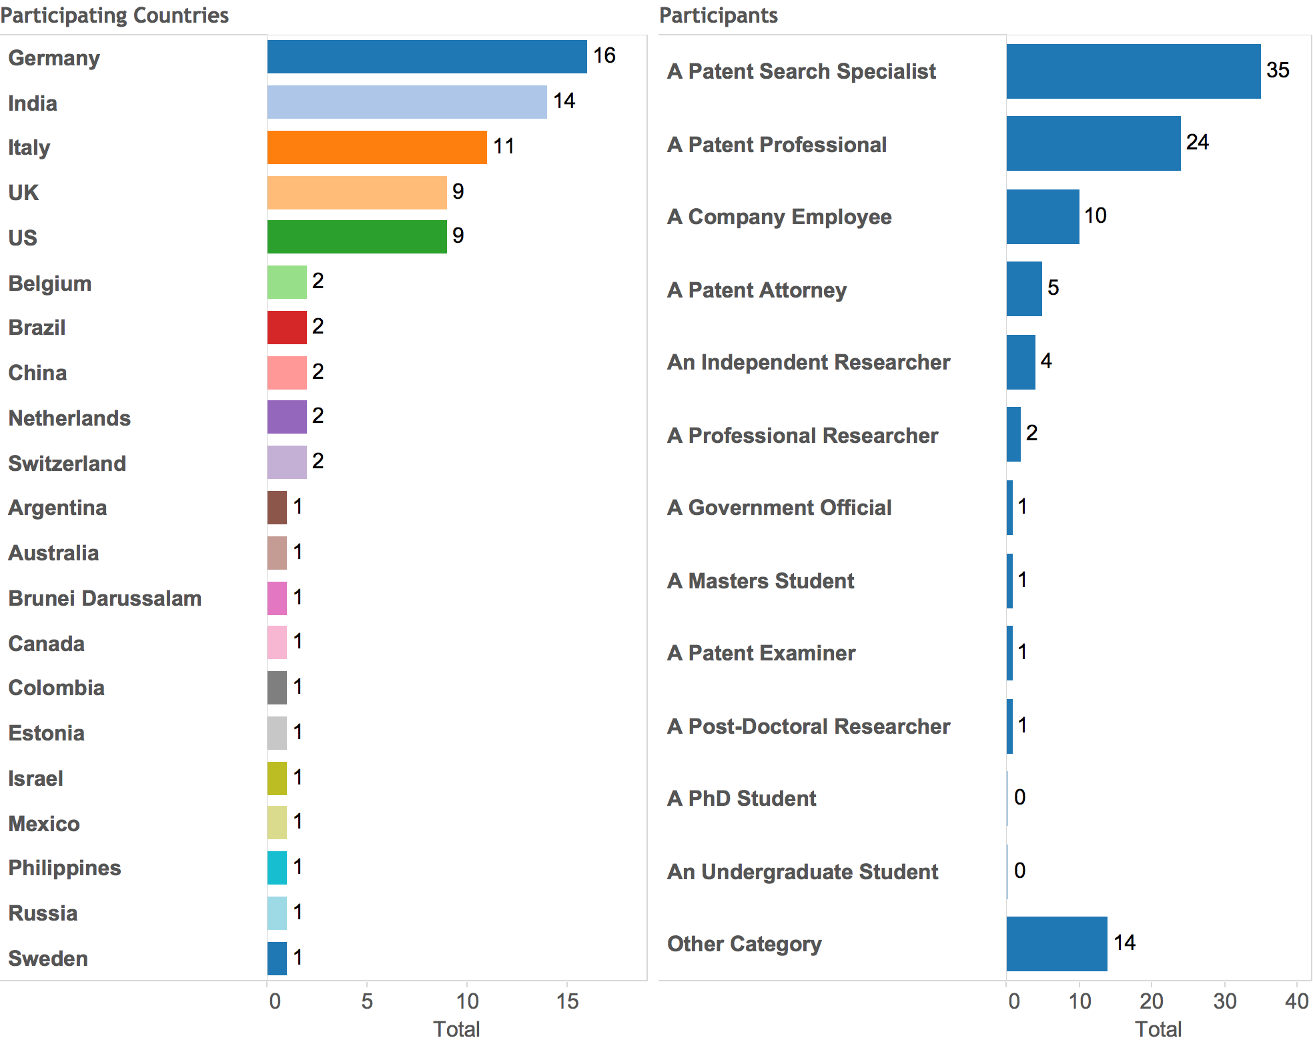
Survey results: participants profile
131 answers from 21 countries, mainly patent search professionals

Slide 13
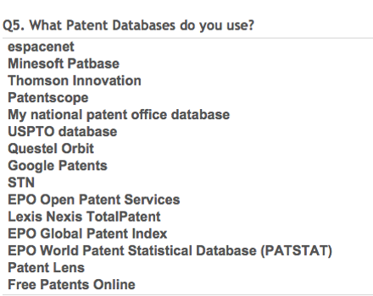
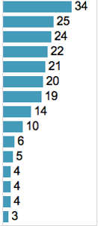
Survey results: Databases used for obtaining data for analytics
Mixture of free and commercial databases
Free databases: espacenet, followed by PATENTSCOPE
Commercial: Patbase, Thomson Innovation, Questel Orbit

Slide 14
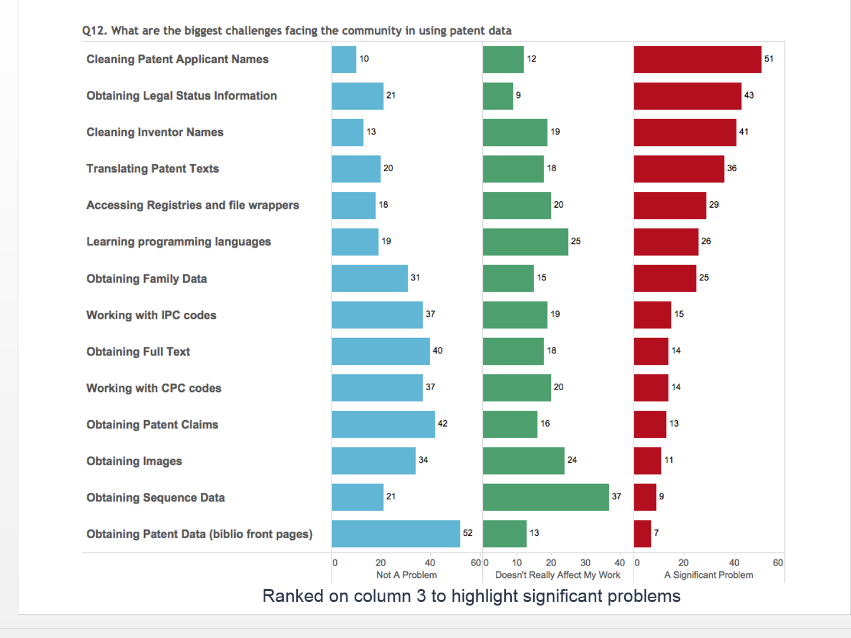
Greatest challenges in patent analytics identified by the survey participants

Slide 15














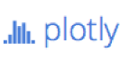
The open source tools era

Slide 16
Typical use of open source tools
Typical user profile:
Researchers
Data scientists
IT
Business analysts
Data typically analyzed through open source tools:
Unstructured data, structured non-patent data
Patent data: not a typical field where open source tools are being used

Slide 17

Pros and cons of open source tools
Advantages
Disadvantages
Free of charge
A lot of them customizable to specific needs
Give flexibility to experiment and choose the tool or combination of tools that is more adapted to the user´s needs
Support and troubleshooting by programmers and other users in various fora
Not as intuitive or user-friendly as commercial tools
Require some programming skills, time and practice
Several bugs/problems
No commercial support

Slide 18

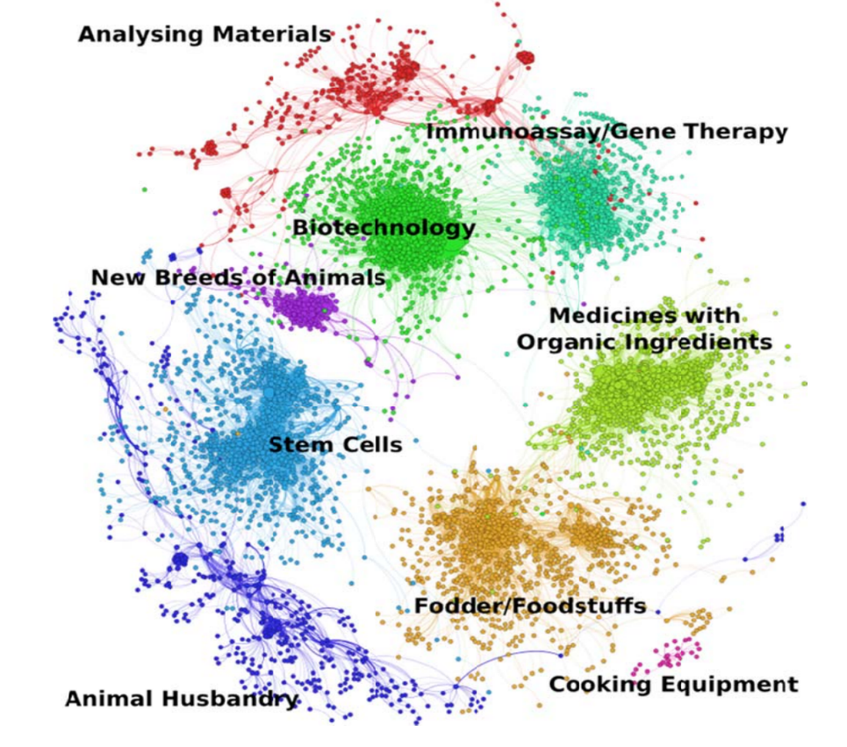
First thoughts on using open source tools for patent analytics
WIPO PLRs 2010-2014: exploring various commercial analysis and visualization tools
2014: WIPO animal genetic resources PLR used for the first time Gephi, an open-source tool.

Slide 19
The Manual on Open Source Tools for Patent Analytics
Project launched in May 2015, funded by FIT-JP
Key author of the Manual: Paul Oldham
Aimed at exploring:
various free and open source tools which could be used for various patent analysis tasks by users in developing countries
How to obtain data to use for patent analytics
How to clean/tidy, analyze, visualize and share patent data with the help of selected open source tools
Challenge: programming skills required
The Manual includes step-by-step instructions on the use of selected open source/free tools

Slide 20
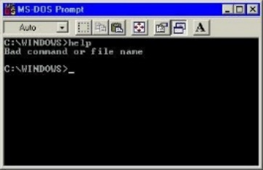
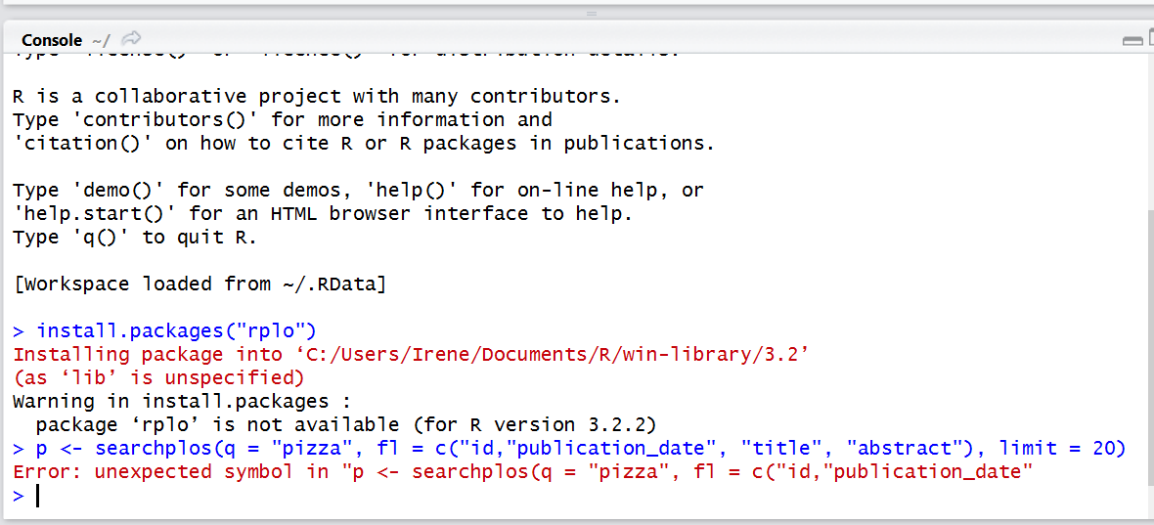
The process and the challenges
1987
2015
Acquiring programming skills – sometimes steep learning curve
Selecting the open source tools to explore and cover in the Manual
Deal with constantly changing open source landscape

Slide 21

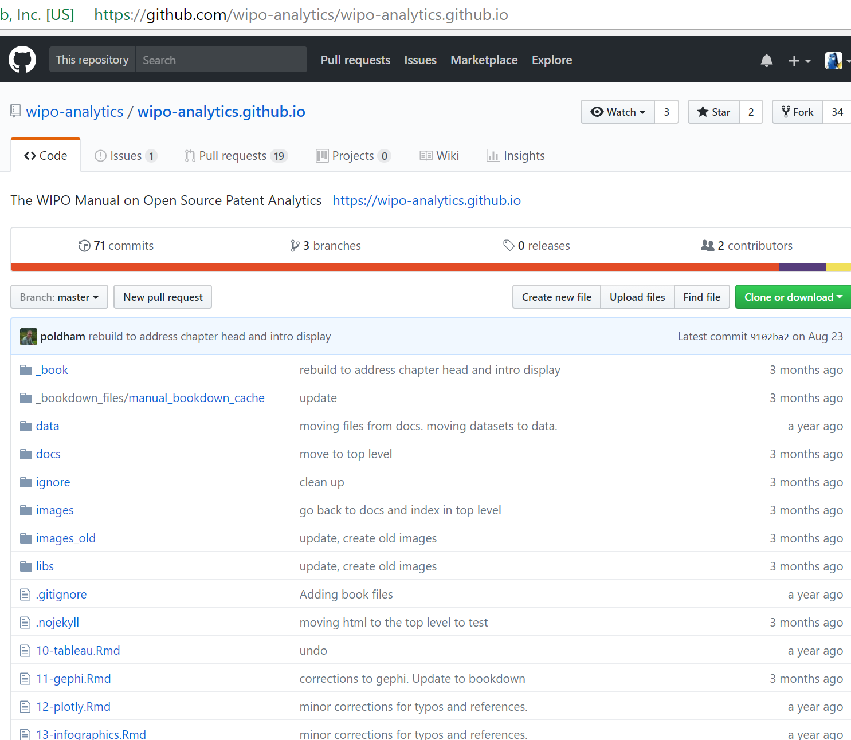
The project approach
The Project Development Site and its Repository – meet Github

Slide 22
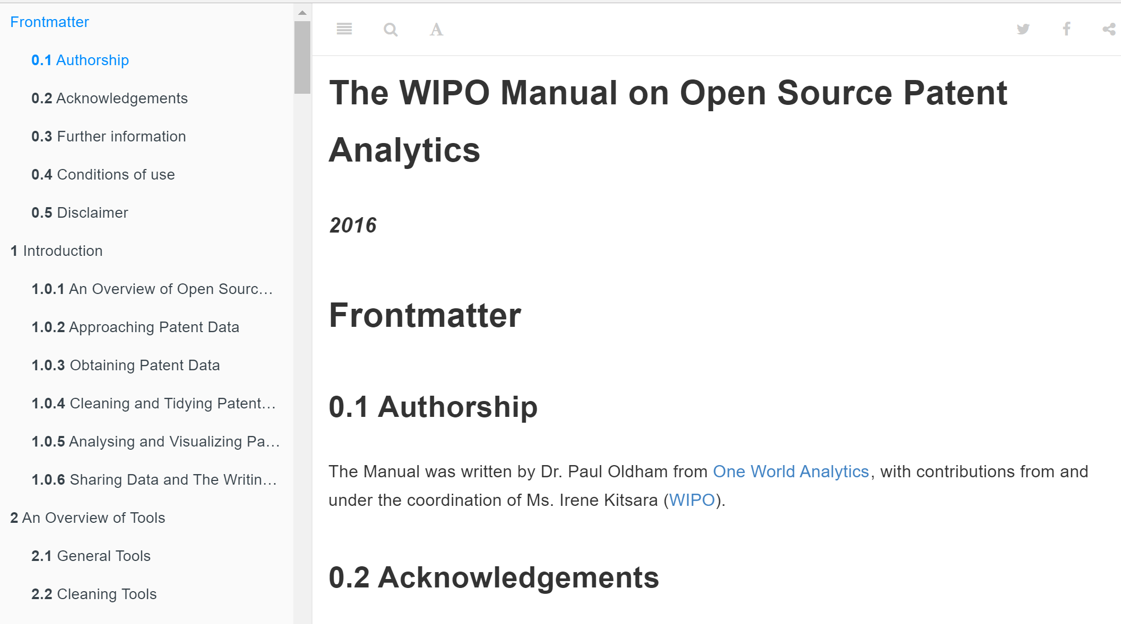
The Manual Repository with the Manual Chapters
The Manual was prepared in RMarkdown
https://wipo-analytics.github.io/

Slide 23
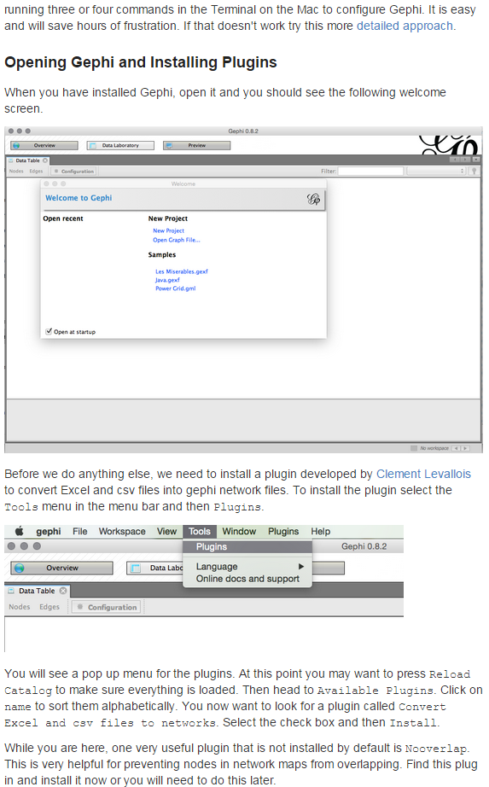
The Manual Chapters
Step-by-step instructions and guidance
Screenshots
Links to tutorials and further useful resources
Tips and tricks

Slide 24












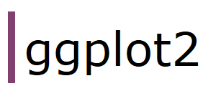


Which analytics tasks, databases and tools does the Manual cover?
Obtaining Data
Cleaning Data
Visualizing Data
Sharing Data

Slide 25
Thank you!

